Slide 1
IBM Research AI
Watson OpenScale
Lukasz Cmielowski, PhD
Daniel Ryszka, MSc
IBM Kraków Software Lab

Slide 2
94%
1 in 20
of companies believe AI is key to competitive advantage .
IDC
companies have extensively incorporated AI in offerings or processes.
MIT Sloan Management Review
Notes:
Data, Skills, Trust
IBM’s institute for Business value just released a survey of 5,000 C-level executives and found that clients are ready, in fact, 82% of enterprises are now considering AI adoption.
However, the MIT Sloan Management Review is showing us that only 1 in 20 companies have extensively incorporated AI.
In our work with our own clients we see the struggles they face in adopting AI. 60% of companies see compliance as barriers to achieving success in applying AI, because they cannot trust the decisions
One of the major barriers for adopting AI is lack of trust. Businesses need to be able to explain how the AI systems came to a certain decision: whether there was bias in data, where was the model built, how did it make certain decisions, etc.
At IBM, we’ve been working diligently to address these issues.
We have been working on trying to solve AI’s “black box” issue.
What does this mean?
Well, we need to demystify AI for businesses. They have heard of the results that they can achieve, but they’re still struggling to be figure out how it works. How do they trust the results?
We’re taking two important steps towards addressing these issues.
The first step is we are introducing a comprehensive new set of trust and transparency capabilities for AI on the IBM Cloud.
What we’ve launched is a software service that explains how AI decisions are reached and flags and helps mitigate bias.
It provides explainability and bias detection on AI models – at runtime – detecting potentially unfair outcomes as they occur.
Importantly, it also automatically recommends data to add to the model to help mitigate any bias it has detected in the AI.
While other open-source resources have focused solely on checking for bias in training data, IBM Research has created the “IBM AI Fairness 360 toolkit” which is the second step.
This toolkit will help developers and data scientists check for and mitigate bias in AI models and we are also making it available to the open source community.
The AI Fairness 360 toolkit is a mix of novel algorithms, code, algorithms, libraries and tutorials that will incorporate known bias-handling capabilities.
This toolkit aligns to IBM’s longstanding commitment to advancing open systems in all technology, including AI.
This is important for our clients because it’s all about visibility into AI decisions.
As I discussed earlier, clients need a way to address the “black box” – they need to trust in AI in order to take advantage of the benefits it can have for their business.
You don’t need to be a data scientist or developer to use this service.
It provides easy to understand terms – why AI made a recommendation – showing which factors weighted the decision in one direction vs. another.
To help prevent bias that may lead to unfair outcomes, the software service can also be programmed to monitor the unique decision factors of any business workflow.

Slide 3
Business stakeholders do not trust AI
60%
Without expensive Data Science resources handholding multiple AI models in a production application:
Very difficult to track and measure indicators of business success in production
Impossible to teach subtle domain knowledge into AI models in production
No way to validate if AI models will achieve expected business outcomes
Risk violating regulatory and enterprise governance requirements
of companies see regulatory constraints as a barrier to implementing AI.
IBM IBV AI 2018
63%
cite availability of technical skills as a challenge to implementation.
- IBM IBV AI 2018

Slide 4
Watson OpenScale
performance
bias detection and mitigation
explainability
operations

Slide 5
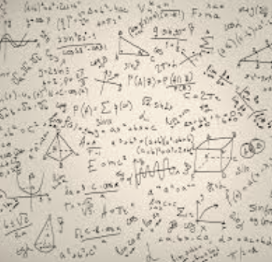


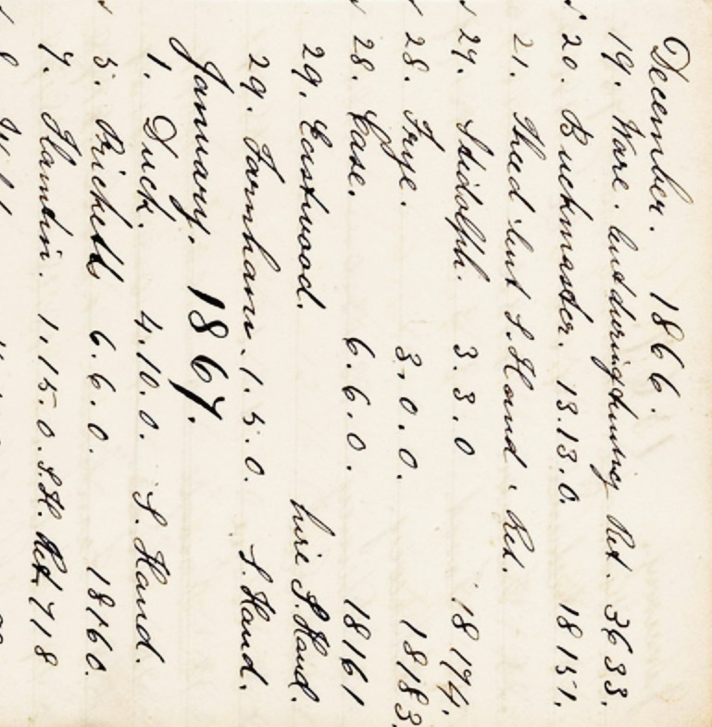
Even if it is accurate, what does it take to trust an AI decision?
It must be understandable
It must be tamper-proof
It must be fair
It must be accountable

Slide 6
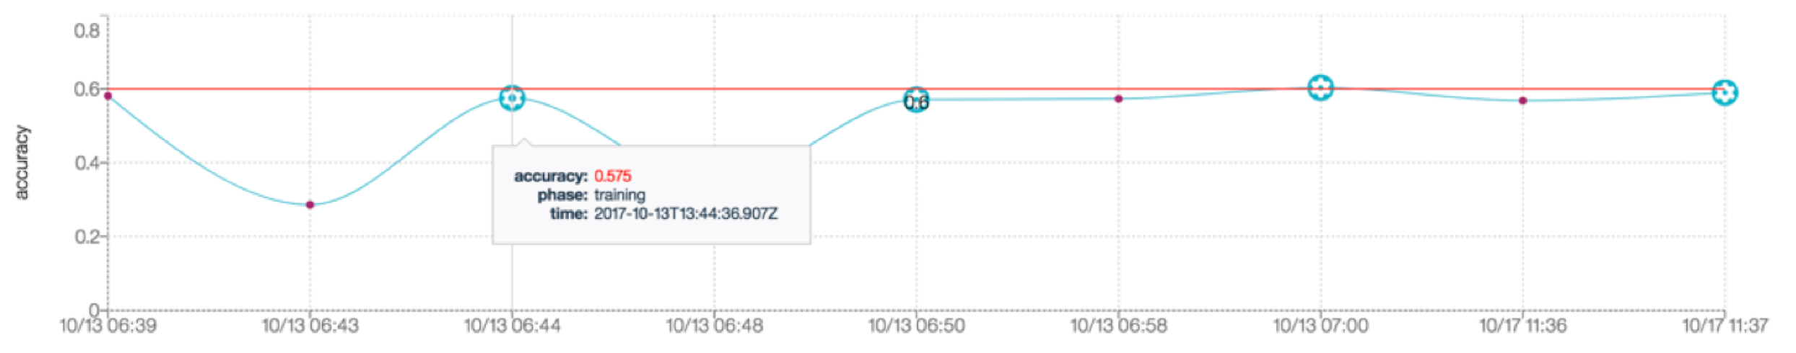
Model accuracy
Legal compliance assistants
language translation
Recall = true positives / (true positives + false negatives)
HVAC controls
Precision = true positives / (true positives + false positives)
Accuracy = numer of correct predictions / all predictions
Notes:
https://www.ibm.com/blogs/research/2018/02/mitigating-bias-ai-models/
// https://www.media.mit.edu/articles/study-finds-gender-and-skin-type-bias-in-commercial-artificial-intelligence-systems/
http://news.mit.edu/2018/study-finds-gender-skin-type-bias-artificial-intelligence-systems-0212
Http://proceedings.mlr.press/v81/buolamwini18a/buolamwini18a.pdf

Slide 7
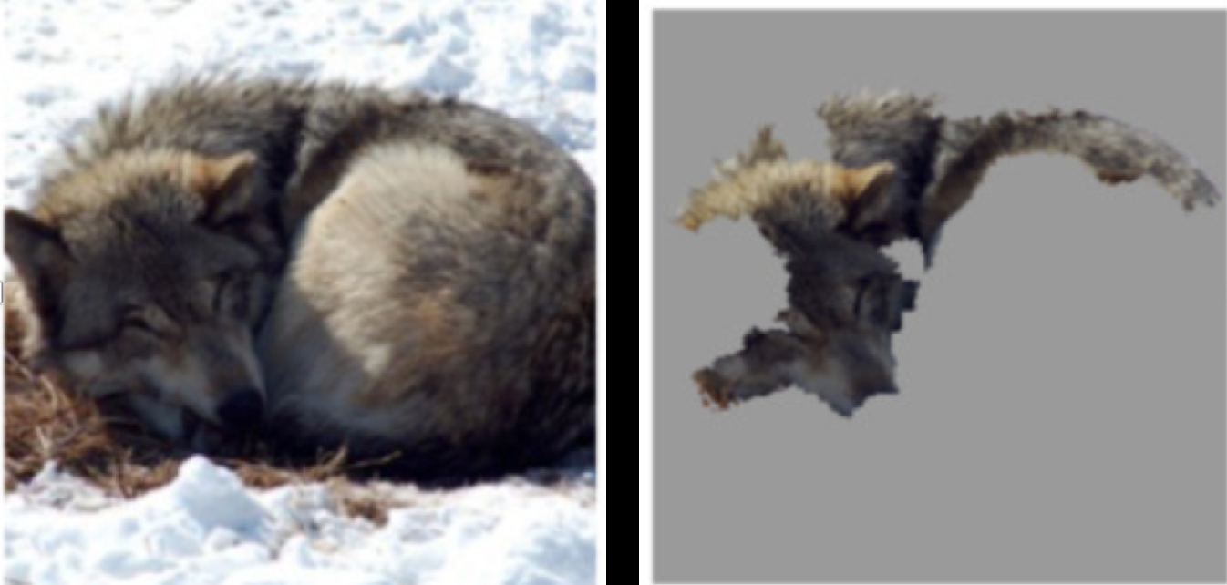
Explanation
Legal compliance assistants
language translation
HVAC controls
Sources: Marco Tulio Ribeiro, Sameer Singh, Carlos Guestrin

Slide 8
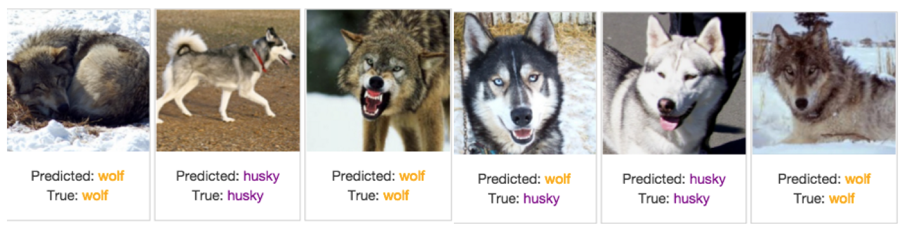
Wolf or Husky?
Sources: Marco Tulio Ribeiro
Only one mistake!
Can we trust this model?
Notes:
University of Washington
“Why Should I Trust You?” Explaining the Predictions of Any Classifier Marco Tulio Ribeiro, Sameer Singh, Carlos Guestrin. https://arxiv.org/pdf/1602.04938.pdf
Also here are slides: https://homes.cs.washington.edu/~marcotcr/
Often artifacts of data collection can induce undesirable correlations that the classifiers pick up during training. These issues can be very difficult to identify just by looking at the raw data and predictions. In an effort to reproduce such a setting, we take the task of distinguishing between photos of Wolves and Eskimo Dogs (huskies). We train a logistic regression classifier on a training set of 20 images, hand selected such that all pictures of wolves had snow in the background, while pictures of huskies did not. As the features for the images, we use the first max-pooling layer of Google’s pre-trained Inception neural network [25]. On a collection of additional 60 images, the classifier predicts
“Wolf” if there is snow (or light background at the bottom), and “Husky” otherwise, regardless of animal color, position, pose, etc. We trained this bad classifier intentionally, to evaluate whether subjects are able to detect it.
The experiment proceeds as follows: we first present a balanced set of 10 test predictions (without explanations), where one wolf is not in a snowy background (and thus the prediction is “Husky”) and one husky is (and is thus predicted as “Wolf ”). We show the “Husky” mistake in Figure 11a. The other 8 examples are classified correctly. We then ask the subject three questions: (1) Do they trust this algorithm to work well in the real world, (2) why, and (3) how do they think the algorithm is able to distinguish between these photos of wolves and huskies. After getting these responses, we show the same images with the associated explanations, such as in Figure 11b, and ask the same questions.
Since this task requires some familiarity with the notion of spurious correlations and generalization, the set of subjects for this experiment were graduate students who have taken at least one graduate machine learning course. After gathering the responses, we had 3 independent evaluators read their reasoning and determine if each subject mentioned snow, background, or equivalent as a feature the model may be using. We pick the majority to decide whether the subject was correct about the insight, and report these numbers before and after showing the explanations in Table 2.
Before observing the explanations, more than a third trusted the classifier, and a little less than half mentioned the snow pattern as something the neural network was using
– although all speculated on other patterns. After examining the explanations, however, almost all of the subjects identi- fied the correct insight, with much more certainty that it was a determining factor. Further, the trust in the classifier also dropped substantially. Although our sample size is small, this experiment demonstrates the utility of explaining indi- vidual predictions for getting insights into classifiers knowing when not to trust them and why.

Slide 9
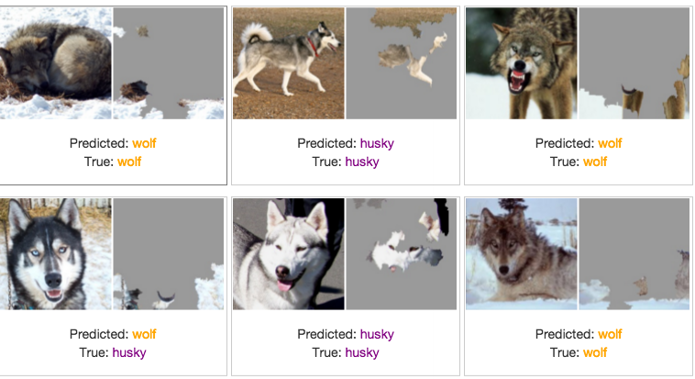
Perfect Snow Detector!
Sources: Marco Tulio Ribeiro

Slide 10
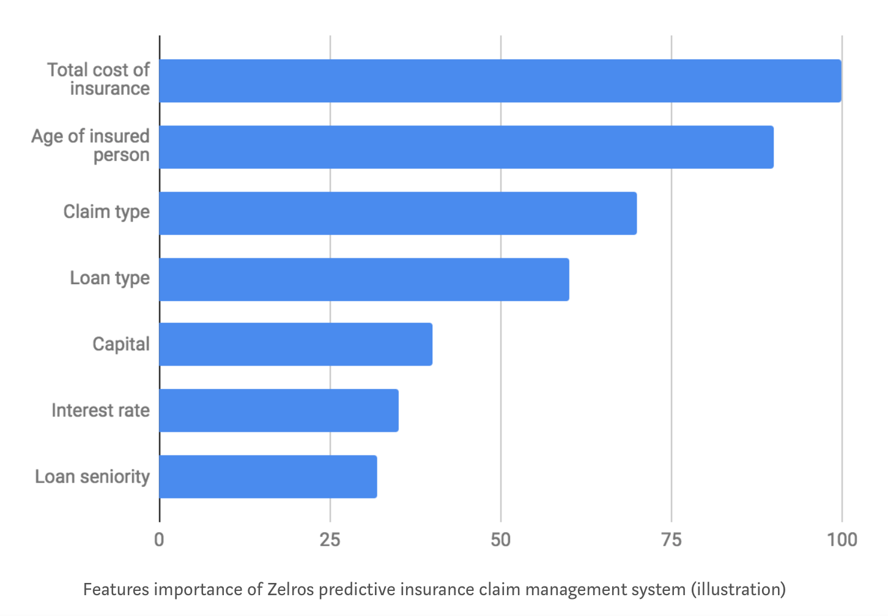
Features Importance
Notes:
https://medium.com/@Zelros/a-brief-history-of-machine-learning-models-explainability-f1c3301be9dc
Features Importance & Features contribution at a given point

Slide 11
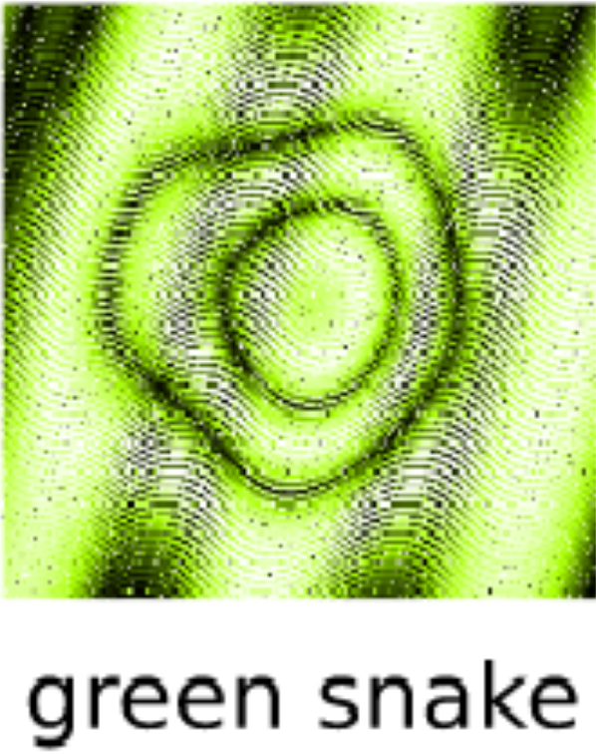

Robustness
Legal compliance assistants
language translation
HVAC controls
Notes:
https://www.youtube.com/watch?v=M2IebCN9Ht4
https://arxiv.org/abs/1412.1897 - stad jest rysunek

Slide 12
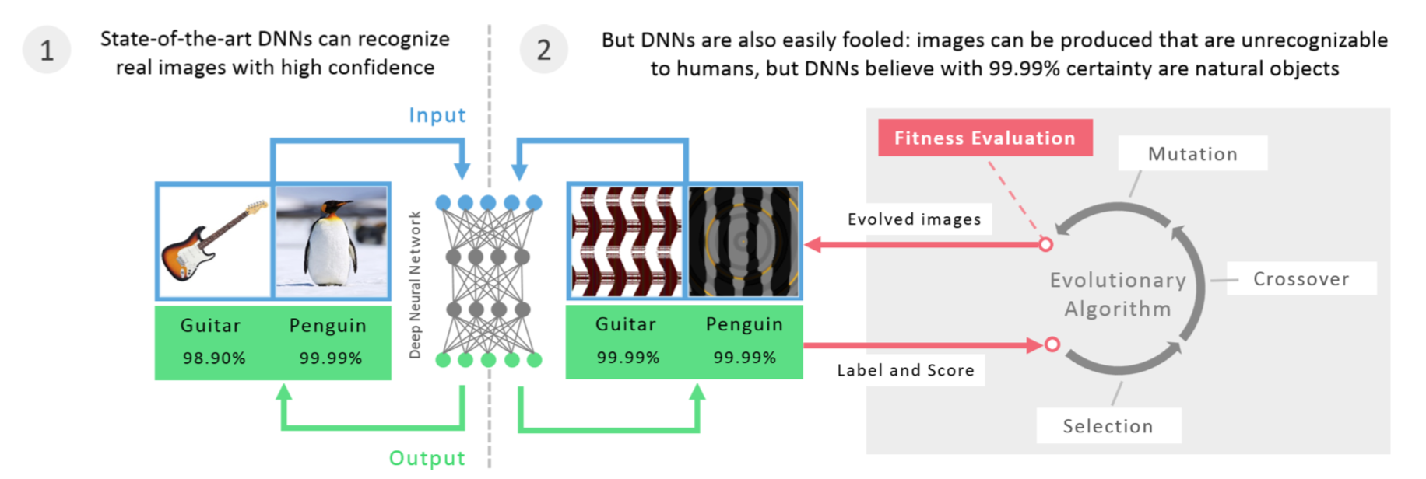
Fooling Images
[Gilmer et al., 2018. Adversarial Spheres. https://arxiv.org/abs/1801.02774]
Notes:
University of Wyoming, Cornell University
https://arxiv.org/abs/1412.1897
Why do adversarial examples exist?
Fooling images:
• DNNs don’t learn actually to recognize e.g. a schoolbus, but to discriminate it from any other object in the training set.
[Nguyen et al., 2014. Deep Neural Networks are Easily Fooled: High Confidence Predictions
for Unrecognizable Images. https://arxiv.org/abs/1412.1897]

Slide 13
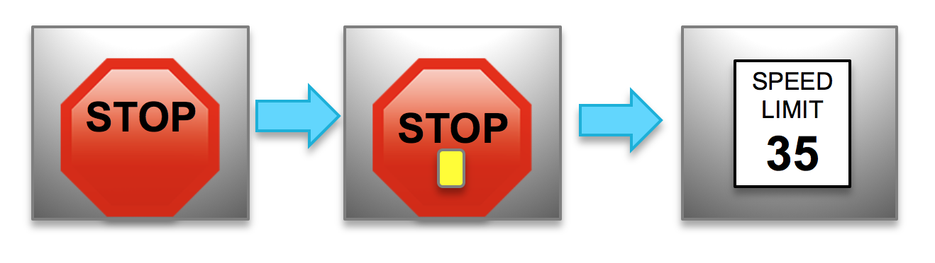
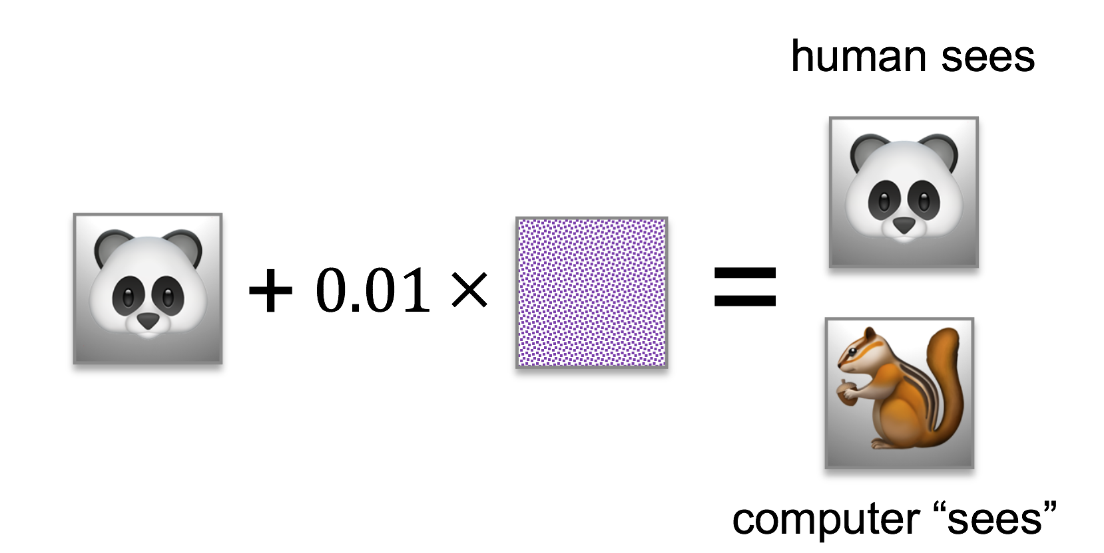
Adversarial Attacks
Poisoning attacks
Performed at training time
Insert poisoned sample in training data
Use backdoor later
Evasion attacks
Performed at runtime
Perturb inputs with crafted noise
Model fails to predict correctly
Undetectable by humans
Notes:
http://www.cleverhans.io/security/privacy/ml/2016/12/16/breaking-things-is-easy.html
The two referenced papers are well known research examples of adversarial attack.
In the evasion attack done by Google researchers, a panda image is mixed with a special perturbation image to confound the image classifier in a trained convolutional neural network. In the original work, the classifier with high confidence classified the perturbed panda image as a gibbon, shown above as a chipmonk.
In the poison attack, NYU researchers trained a neural network with a backdoor trigger that cause a complete misclassification. In this case, the trigger was a yellow Post-It note.

Slide 14
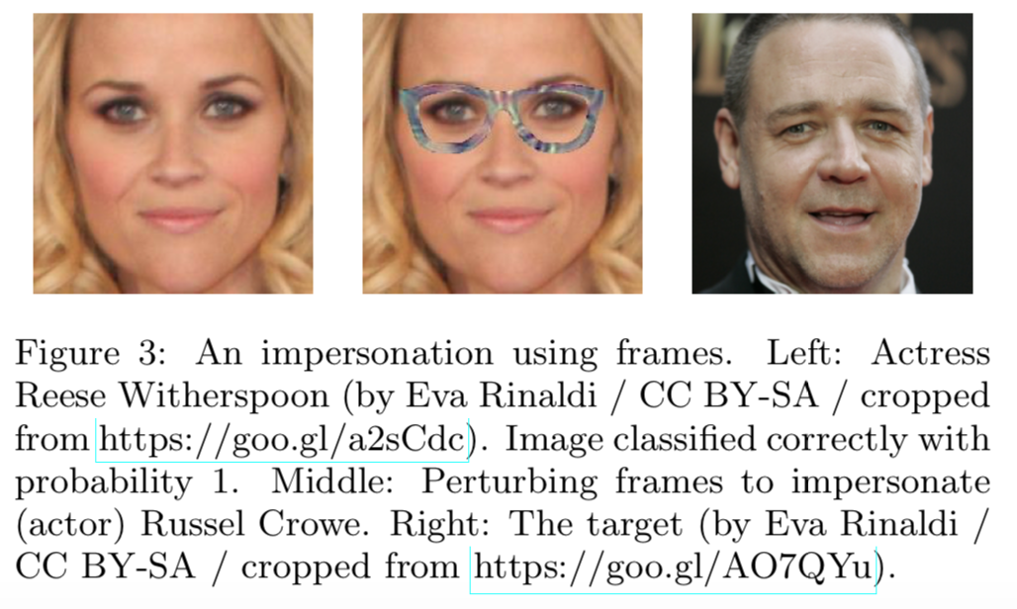
Evasion Attack - Digital and Physical World
[Sharif et al., 2016. Accessorize to a crime: Real and Stealthy Attacks on State-of-the-Art Face Recognition. ACM SIGSAC Conference on Computer and Communications Security (CCS)]
Notes:
Carnegie Mellon University
https://www.archive.ece.cmu.edu/~lbauer/papers/2016/ccs2016-face-recognition.pdf

Slide 15
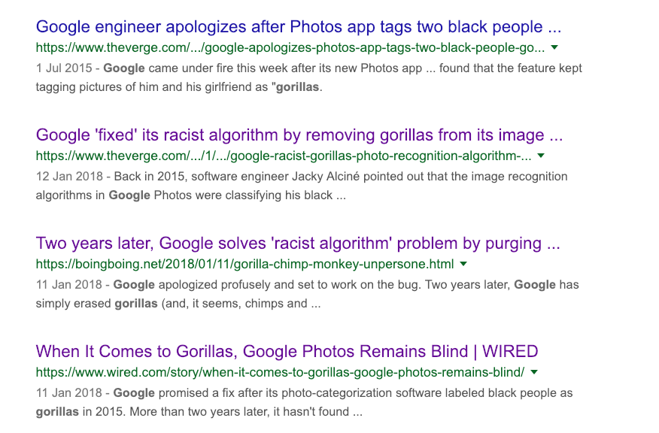
Machine Bias
Legal compliance assistants
language translation
HVAC controls
Sources: Jacky Alcine/Twitter
Notes:
https://www.ibm.com/blogs/research/2018/02/mitigating-bias-ai-models/
// https://www.media.mit.edu/articles/study-finds-gender-and-skin-type-bias-in-commercial-artificial-intelligence-systems/
http://news.mit.edu/2018/study-finds-gender-skin-type-bias-artificial-intelligence-systems-0212
Http://proceedings.mlr.press/v81/buolamwini18a/buolamwini18a.pdf

Slide 16
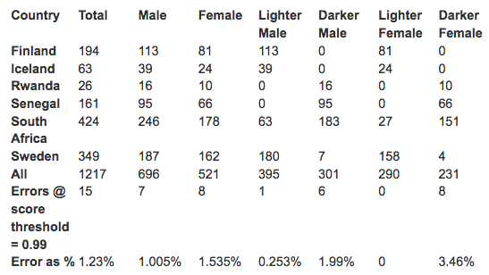
Bias Mitigation at Model Design Time IBM Visual Recognition
Notes:
To evaluate IBM’s new service in a manner consistent with their study, IBM Research gathered images of parliamentarians from Finland, Iceland, Rwanda, Senegal, South Africa and Sweden. This dataset is very similar to the Pilot Parliaments Benchmark. However, the experiment conducted by IBM Research differs slightly from the one used in the paper [1] in two ways. First, the dataset is slightly different as a new election in Senegal has changed the member photos and Rwanda has a smaller number of photos. Thus, IBM Research used 1,217 faces versus the 1,270 reported in the paper. Secondly, we labeled the “lighter” and “darker” classes for the faces manually without using the Fitzpatrick score. We believe that these two, minute differences do not impact the conclusions of the experiment. The table below illustrates our results.

Slide 17
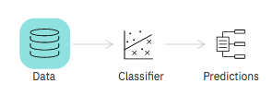
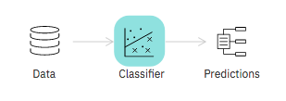
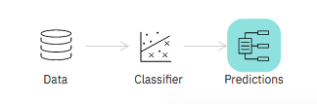
Bias Mitigation
Fix the data (pre-process)
Disparate Impact Remover
Learning Fair Representations
Optimized Preprocessing
Reweighing
Fix the classifier (in-process)
Adversarial Debiasing
ART Classifier
Prejudice Remover
Fix the predictions (post-process)
Calibrated Equality of Odds
Equality of Odds
Reject Option Classification
Notes:
http://aif360.mybluemix.net/mitigate
https://aif360.readthedocs.io/en/latest/modules/algorithms.html
https://towardsdatascience.com/a-gentle-introduction-to-the-discussion-on-algorithmic-fairness-740bbb469b6
1/ Fairness of the process (at design time) vs fairness of the outcome (at runtime)
2 / aware & unaware approach; pominiac dane czy nie?)
3/ Statistical Parity (wymuszanie tego to jak rzucanie monetą)
4/ Cross group calibration (Instead of equalizing the outcomes themselves, we can equalize some statistics of the algorithm’s performance: for example, equalize the error rates across groups. A fair algorithm for screening resumes, in this view, is one that makes just as many mistakes on male applicants as it does on female applicants.)
5/ Trad-offs – czy poprawa tej czy innej miary jest lepsza…
Fix the data (pre-process)
Disparate Impact Remover
Learning Fair Representations
Optimized Preprocessing
Reweighing https://core.ac.uk/download/pdf/81728147.pdf
Fix the classifier (in-process)
Adversarial Debiasing
ART Classifier
Prejudice Remover
Fix the predictions (post-process)
Calibrated Equality of Odds: https://papers.nips.cc/paper/7151-on-fairness-and-calibration.pdf
Equality of Odds: https://papers.nips.cc/paper/6374-equality-of-opportunity-in-supervised-learning.pdf https://papers.nips.cc/paper/7151-on-fairness-and-calibration.pdf
Reject Option Classification: https://mine.kaust.edu.sa/Documents/papers/ICDM_2012.pdf
Fix the predictions (post-process)
Calibrated Equality of Odds: https://papers.nips.cc/paper/7151-on-fairness-and-calibration.pdf
Equality of Odds
Odd – szansa (stosunek
Reject Option Classification: https://mine.kaust.edu.sa/Documents/papers/ICDM_2012.pdf

Slide 18








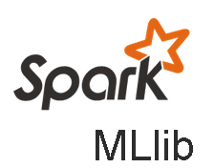



Watson OpenScale plus Watson Studio and WML Operationalize AI across the enterprise
Build
Deploy and run
Operate trusted AI
IBM TOOLS
IBM AI RUNTIME
Manage AI at scale
Watson Studio
Watson Machine Learning
Watson OpenScale
3RD PARTY IDE & FRAMEWORKS
3RD PARTY RUNTIMES
Business KPIs
Validation & feedback
Azure ML
Accuracy
Fairness & Explainable AI
Inputs for Continuous Evolution
Automated Anomaly and Drift detection
Build AI
Run AI
Operate AI
Consume AI
Data Scientist
App Developer
AI Ops
Business user
18
Notes:
Watson OpenScale achieves these goals by focusing on 3 stages of an AI application’s lifecycle: Build, Run and Manage. At build time, data scientists use their preferred popular open source frameworks and tools while gaining access to toolkits for bias detection and explainability of transactions. Development and operations teams then scale and manage AI applications using their existing DevOps tools and processes in the runtime environment. We are actively working to support 3rd party runtimes along with tighter integration into Watson services like Visual Recognition and Natural Language Classifier.
And finally, business users are then able to measure and trace the outcome of individual AI workflows for auditing and regulatory purposes.

Slide 19
How do we reduce credit prediction risk at runtime?
application
Automated risk identification and resolution
model
data
governance
model
build-time
model runtime
monitor
mitigation
explanation
business owner

Slide 20
You’re confronted with this business scenario
Deliver low cost financial services with transparent credit risk modeling
LOAN
credit lender
LOAN APPLICANTS
INCREASE
LOANS
data science
team
REDUCE
RISK
Notes:
To understand how Watson OpenScale brings trust and transparency to machine learning models, let’s explore the challenges facing a consumer credit lender that wants to expand their services to a larger and more diverse group of applicants.

Slide 21
You’re confronted with this business scenario
Deliver low cost financial services with transparent credit risk modeling
LOAN
credit lender
LOAN APPLICANTS
lender’s data
risk model
3rd party data
data science
team
Notes:
As many of these people may not have standard credit histories, the data science team has to ingest larger and more varied data sources. To make sense of all this complicated data, they can’t rely on traditional analytics approach and must resort to advanced machine learning algorithms.

Slide 22
Architecture overview
Application
model deploy service
Watson Machine Learning
data mart in postgres
PREDICTION PAYLOAD
Payload
Watson OpenScale
Feedback
accuracy
bias
prediction rate
explanation
custom metrics
…
Derived Statistics
MONITOR

Slide 23
Hands-on lab
github.com/pmservice/OpenScale-Labs

Slide 24
ibm.biz/aiopenscale

Slide 25
Watson OpenScale: Supported Model Types
Algorithms | Fairness | Auto - Debias | Explain | Accuracy
Structured Classification: | Yes¹ | Yes¹ | Yes | Yes
Structured Regression: | Yes | Coming soon | Yes | Yes
Text: Classification: | No – Active research topic |  | Yes | Yes
Image Classification: | No – Active Research Topic |  | Yes | Yes
¹ If your model / framework outputs prediction probabilities
Notes:
Classification Structured and Regression Structured using Tensorflow or Keras will not be supported

Slide 26
Watson OpenScale: Supported Frameworks
Algorithms | Out of the box Support | Support through Custom Environment (Show me how) Support through Python Functions (Show me how)
Structured: Classification | Spark mllib on WML, AWS Sagemaker Native, Azure ML Studio Native | Scikit-Learn, XGboost, SPSS, Keras, Tensorflow, Pytorch, Caffe, or any other framework of your choice
Structured: Regression | Spark mllib on WML, AWS Sagemaker Native, Azure ML Studio Native | Scikit-Learn, XGboost, SPSS, Keras, Tensorflow, Pytorch, Caffe, or any other framework of your choice
Text: Classification | Spark mllib on WML | Coming Soon: Keras, Tensorflow, Pytorch, Caffe, and most others
Image: Classification | Keras on WML | Coming Soon: Keras, Tensorflow, Pytorch, Caffe, and most others
Notes:
Classification Structured and Regression Structured using Tensorflow or Keras will not be supported

Slide 27


Key wins in 2018
Confidential
Internal use only
Customer is going to use Watson OpenScale as a tool to provide transparency and assurance to the business stakeholder across internal audit/risk management groups who are creating AI models for various functions including credit management and fraud.
Building an enterprise class platform to provide monitoring of models across variety of frameworks and serve environments. The emphasis is on measurement of model accuracy plus black box explainability – Model accuracy, identifying degradation over time and model ops are primary needs.

Slide 28
Where to get content and help?
Learn the offering - http://ibm.biz/sellaiopenscale
Offering overview
Features overview
Sales FAQ
Tech FAQ
Sizing, Pricing and packaging
Tech discovery questionnaire
Demo (with script)
Competitive perspective
Use cases
Find opportunities - http://ibm.biz/sellaiopenscale
Discovery questions
Buying occasions
Customer profile
Sales plays
Key Contacts:
Michael Scruggs (mscruggs@us.ibm.com)
Global Sales Leader, IBM Data Science
Rahul Akolkar (akolkar@us.ibm.com)
WW Technical Sales Leader, Watson Data and AI
Rohan Vaidyanathan (rvaidya@us.ibm.com)
Anthony Stevens (apsteven@us.ibm.com)
Anshu Jain (anshujain@us.ibm.com)
Offering Management
Slack
#ai-openscale : General questions
#ai-openscale-sales : Sales winroom
#ai-openscale-support : Tech support

